Slide 1
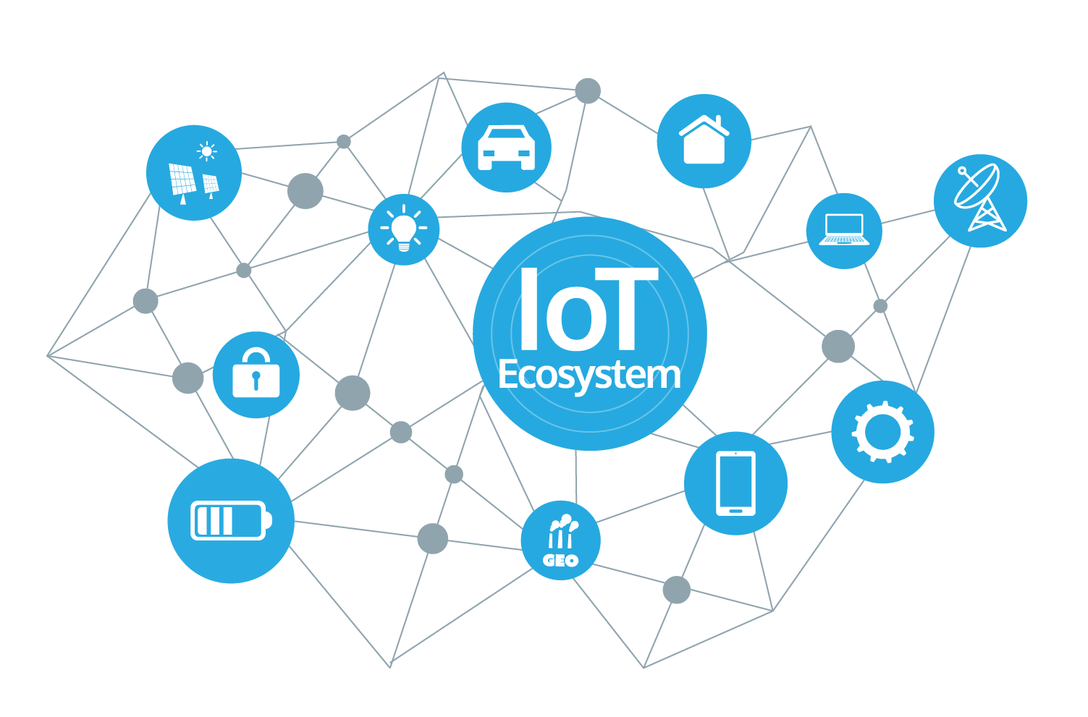
INTRODUCTION TO INTERNET OF THINGS - COMP6121-112
Assignment I
Report of paper selection
INTRODUCTION TO INTERNET OF THINGS - COMP6121-112
Assignment I - Report
A Blockchain Footprint for Authentication of IoT-Enabled Smart Devices in Smart Cities: State-of-the-Art Advancements, Challenges and Future Research Directions
Present by
P2213046 王榮勝 Rongsheng Wang, Mark P2213913 詹澤齊燁 Zeqiye Zhan, Janzen P2213983 李俊蓉 Junrong Li, Rachel P2212990 李宇昆 Yukun Li, Leo
Sep 27, 2022

Slide 2
presenter
LI YUKUN

Slide 3

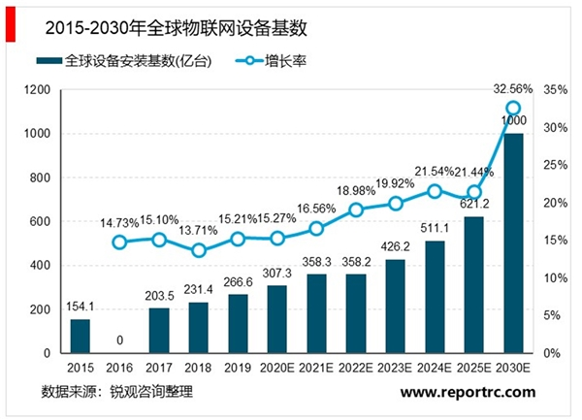
背景介绍
background
Global sensor count
growing tendency
The global sensor market is expected to reach US$128.56 billion by 2025
——ReportLinker

Slide 4
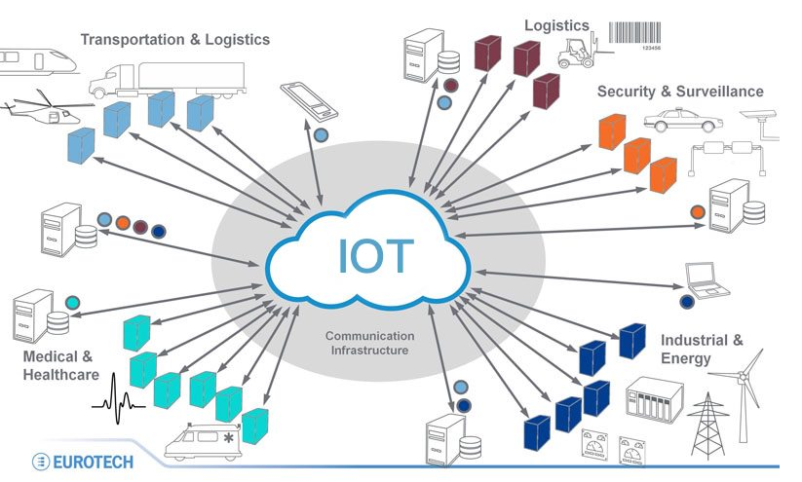
背景介绍
Introduction
WHY
Cyber attackers prefer to attack these sensors ?
Low-power
Long-life devices
Data collection
Storage

Slide 5
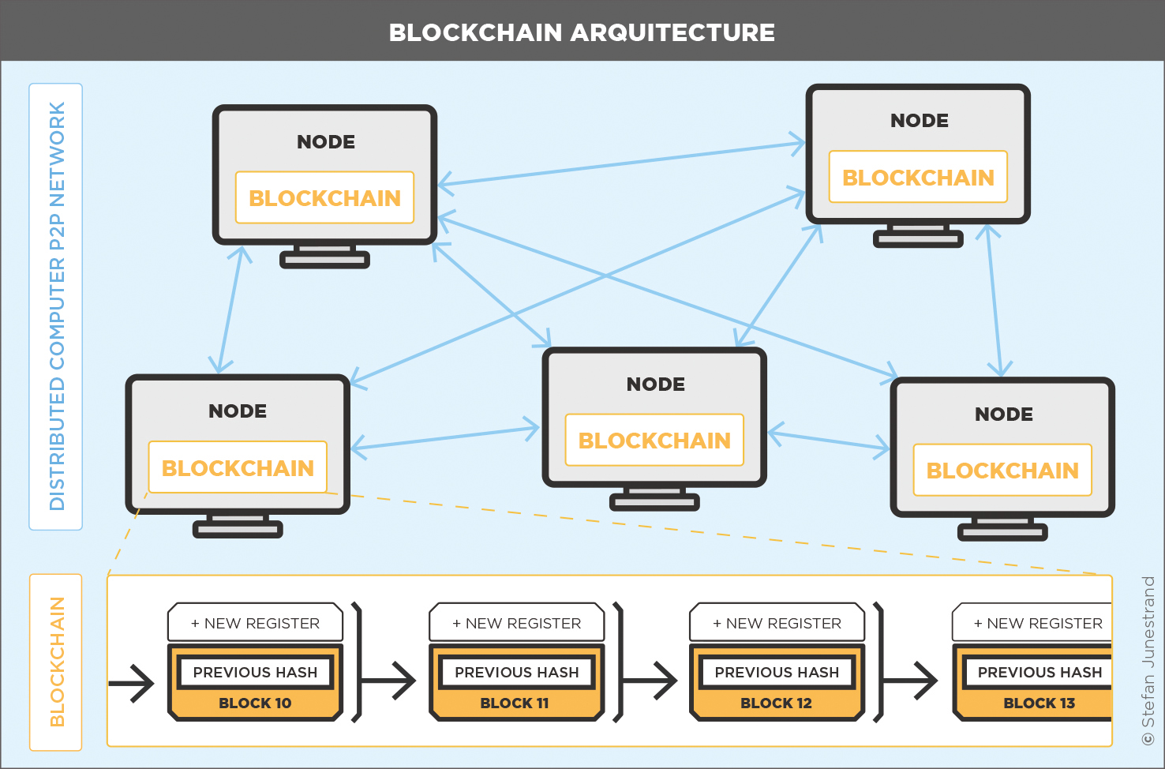
背景介绍
Traditional model and block Chain model
TCP/IP
Application
Transport
Internet
Network Interface
In cloud computing,
communication of sensor is TCP/IP model
Traditional model is Not designed by connecting so many sensors
Blockchain is good at deal with these sensors
Block chain has a unique way to keep data safe

Slide 6
Smart City Layered Adversaries
corresponding adversaries
1
Application
Application Layered Adversaries
Transmission Layered Adversaries
2
Transmission
Sensing Layered Adversaries
3
Sensing Layer

Slide 7
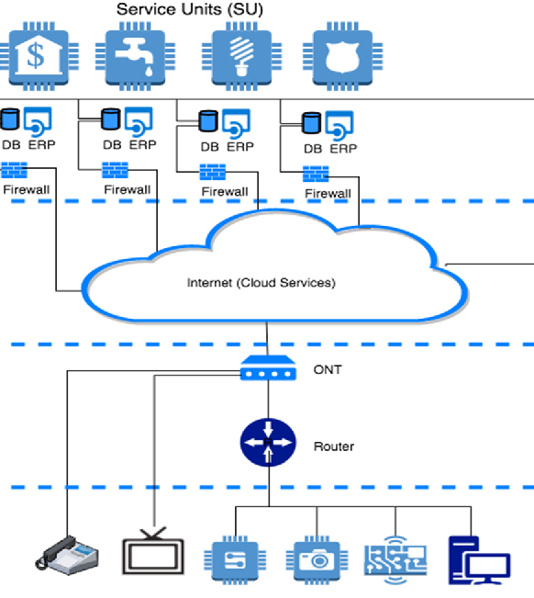
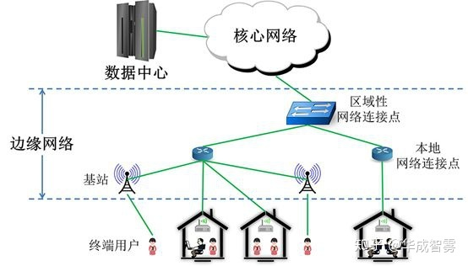
背景介绍
cloud computing and Edge/fog computing
Cloud computing
Edge/fog computing
?
Node can’t computing
Data is analyzed, processed and aggregated on the cloud
All node can be fog node
All fog node can computing
Data will not be concentrated in one point

Slide 8
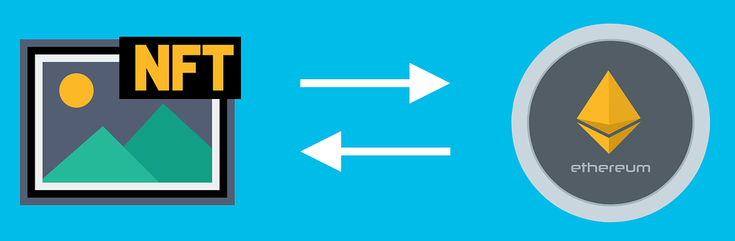

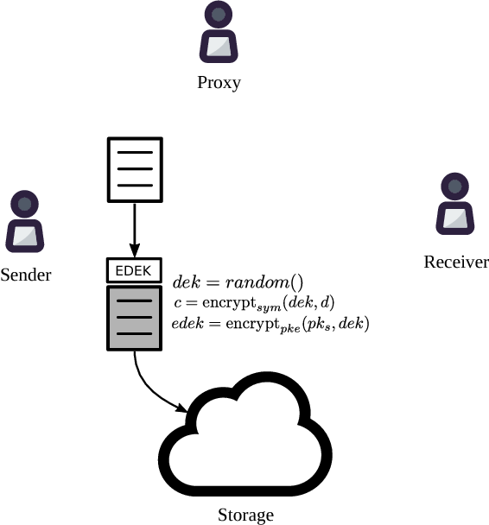
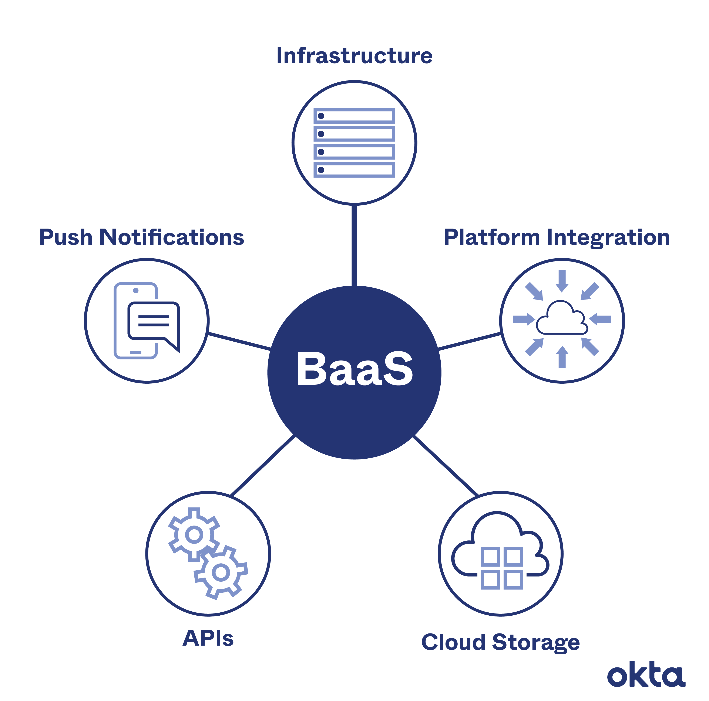
The future of blockchain and iot
Non-Fungible Token
NFT
Baas
Block chain and iot
Block as a serve
Combination blockchain and iot
Decentralized key Management system

Slide 9
presenter
LI JUNRONG

Slide 10

背景介绍
Smart City Layered Architecture
The smart city architecture can be classified into layers based on the feature in a physical cyberspace environment.
Smart city architecture can mainly be divided into three-layered architecture:
application layer
transmission layer
sensing layer.

Slide 11
背景介绍
Generalized Smart City Layered Architecture.
Application Layer
Provides a platform for people to use
Executes commands based on data from the devices at the sensing layer
B. Transmission Layer
Communication among the devices between the layers.
Carries and transmits information
1
Application
2
Transmission
3
Sensing Layer
C. Sensing Layer
Identify things and collect the information.
Many types of sensors attached to objects to collect information
The information can be about location, environment ,motion…

Slide 12
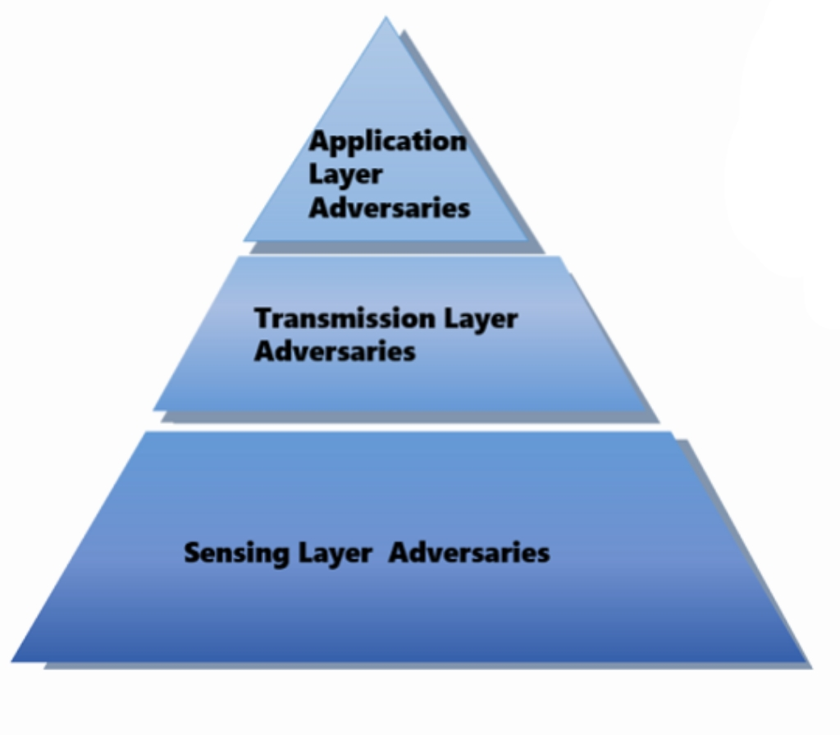
Smart City Layered Adversaries
SECURITY IS THE KEY ISSUE
COMMON ATTACKS
Injection Attacks
Parameter Tampering
Buffer Overflow Attacks

Slide 13
Smart City Layered Adversaries
TARGETED BY
Obstruct the network resources
Bombard the fake data
COMMON ATTACKS
worm attacks
Denial-of-Service attacks (DoS).
Repudiation attacks

Slide 14
Smart City Layered Adversaries
MANY TYPES OF SENSORS
Sensors lack of network security and authentication
COMMON ATTACKS
physical attacks
port scanning attacks
replay attacks

Slide 15
presenter
ZHAN ZEQIYE

Slide 16






背景介绍
Blockchain of IoT in Smart Cities
Vision sensor
Signal sensor
Light sensor
Temperature Sensor
+
+
+
+
Authorization and Authentication
Normal IoT in Smart Cities
Decentralized IoT in Smart Cities
Server

Slide 17



Authentication Architectures in Smart Cities
IoT sensors & services
- Product, calculate & store data
- Separate individuals
- Public distributed blockchain ledger
- Register names and store associated values
- Two Steps: Registration and Authentication
- Open Source smart solution platform
- Decentralization of authentication and authorization
logic stays outside the blockchain
- Rich standard API & Provides advanced interaction

Slide 18
Improvement by other features
- An Ethereum-based smart contract for edge computing
- Low-cost, low-overhead tool for compute-resource management.
- Five states: Unavailable, Available, Pending, Computing, Completed
- Evaluate performance based on low overhead latency and transaction cost of executing jobs
Smart Edge
- Enhance network security by analyzing network traffic patterns of devices
obtained from data stored in the blockchain
- Two parts for Authentication: registration and fraud detection.
- The time complexity is O(m * n) and O(m). When there are "m" IoT devices
Blockchain of
Things Sentry
- One-time password authentication solution
- Requiring users to authenticate once helps avoid the fatigue of adding passwords over and over
- Use public blockchains (Bitcoin and Namecoin) and consensus mechanisms to improve usability
- Make user authentication no longer dependent on a third party
Single Sign-On

Slide 19
presenter
WANG RONGSHENG

Slide 20
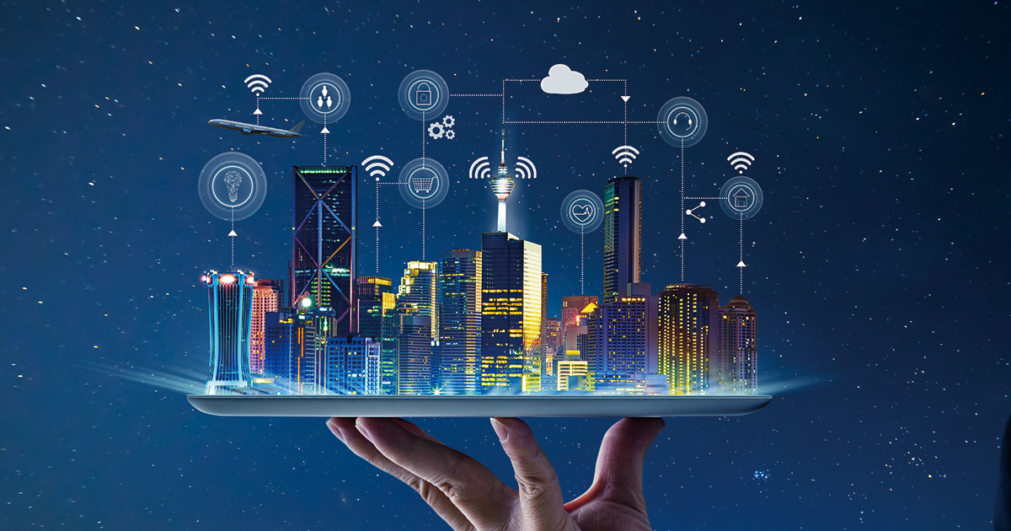
背景介绍
Recent Advancements & Future Research Directions
In smart city infrastructure, the data is transmitted from multiple CPSs to the security operations center (SOC) over the internet, posing security threats in different communication architectures of the smart city.
BaaS
Non-Fungible Tokens
Cryptosystems

Slide 21
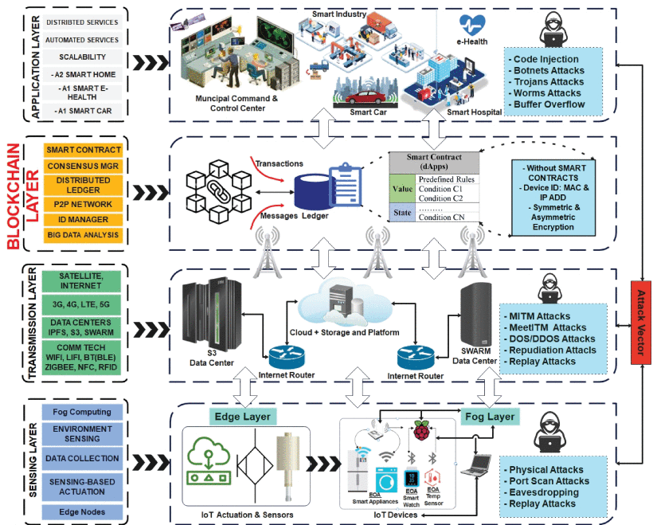
背景介绍
Baas
The blockchain-based architecture that adds a BC layer to the generalized smart city layered architecture presented.
After joining the BC layer, we need to pay more attention to the research on the following issues in the future:
Security Services: Weaknesses and Threatstransmission layer.
Anonymity and Data Privacy.
IoT-Enabled Assets Firmware Upgrade.
Storage Capacity and Scalability.

Slide 22

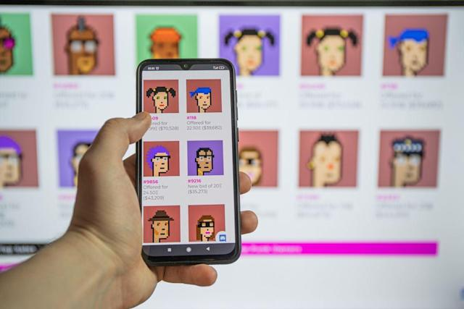
背景介绍
Non-Fungible Tokens
Immutable
The NFTs represent the ownership of physical or digital assets such as physical property, virtual collectibles, or negative value assets.
We believe these tokens can be used to identify and authenticate assets in a smart city infrastructure where users and devices can be identified by a public key and transact uniquely by the identified tokens.
Notes:
非同值化代币是独一无二，不可分割的，比如艺术品、游戏里的虚宝甚至是房产证明或红酒的履历证明，当你交易出去这个非同质化代币时，你就不再拥有它，没有找零的概念。
而且因为 NFT 发行在链上，只要链还存在，你拥有 NFT 的纪录就不会被窜改、抹灭、消失，在发行 NFT 代币的合约中，会纪录着这个代币的识别讯息，可能仅是一串ID又或者会标注更多讯息，来证明这个代币可以代表的具体资产，这些讯息就如同刚才所提的无法被篡改。

Slide 23
背景介绍
Cryptosystems
SHA (Secure Hash Algorithm) has been used to generate cryptographic hashes for secure communication and record changes in the original data.
SHA-0
structural similarities to MD5 and MD6 hashing functions.
SHA-1
SHA-2 refers to the hash family of six hash functions such as SHA-224, SHA-256, SHA-384, SHA-512, SHA-512/224, and SHA-512/256.
SHA-2
SHA-3 is different.SHA-3 is a Permutation-Based Hash and Extendable-Output Function employs information security and assures data integrity in digital transactions.
SHA-3
Notes:
So it can be implied to authenticate assets in a smart city infrastructure where users and devices EOAs can be utilized with global variables and public/private keys in a distributed environment, such as blockchain.

Slide 24
THANK YOU FOR ATTENTION !!!

